Slide 1
Your High School Journey
A Guide for What You Need to Know to Make a Successful Transition to Greenfield-Central H.S.

Slide 2
Meet Your Tour Guides
Mr. Horsman A-E
Mrs. Foster F-L
Mrs. Knecht M-Sq
Mrs. Kile St-Z

Slide 3
Your Packing List for a Successful Journey
Academic skills (Finish your 8th grade classes strong so that you are prepared for your freshman classes.)
An ability to advocate for yourself (Can you e-mail a teacher if you need help?)
A sense of adventure (Get involved and stretch yourself.)
A strong work ethic (Can you balance multiple activities and are you always pushing yourself to do your best?)
An idea of where you want to be after high school
An understanding of resiliency (Can you cope with frustration and not always being perfect?)

Slide 4
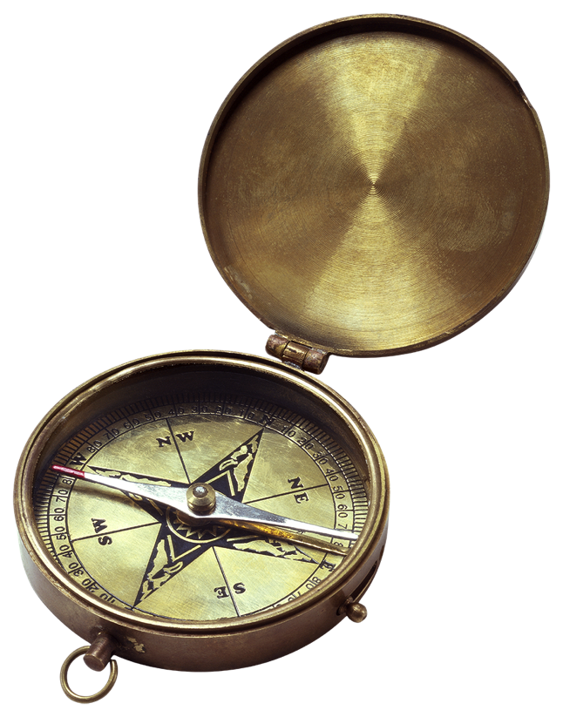
Your Road Map
Courses
State Exams (GQE)
Graduation Requirements for Students in the Class of 2022

Slide 5
Course Requirements
http://www.doe.in.gov/ccr/indianas-diploma-requirements

Slide 6
Core 40 Diploma
English 8 credits
Math* 6 credits (in grades 9-12)
Science 6 credits
Social Studies 6 credits
PE 2 credits
Health 1 credit
Direct Electives 5 credits
(World Lang., Fine Arts, Career/Technical)
Electives 6 credits
(College & Career Pathway courses)
*Students must take a math or QR course each year in high school.

Slide 7
Core 40 with Academic Honors Diploma
Complete the Core 40 requirements
Earn 2 additional Core 40 math credits
Earn 6-8 Core 40 World Language credits
Earn 2 Core 40 fine arts credits
Earn a grade of “C” or better in courses that count toward the diploma
Have a GPA of “B” or better
Complete one of the following:
Earn 4 credits in 2 or more AP courses/take corresponding AP exams, OR
Earn 6 verifiable transcripted college credits in dual credit courses from Core Transfer Library, OR
Earn 3 verifiable transcripted college credits and 2 AP credits, OR
Earn a qualifying SAT or ACT score as determined by DOE

Slide 8
Core 40 with Technical Honors Diploma
Complete the Core 40 requirements
Earn 6 credits in college and career preparation courses in a state-approved College & Career Pathway, and one of the following:
1. Pathway designated industry-based certification or credential, or
2. Pathway dual-credits from the lists of priority courses resulting in 6 transcripted college credits
Earn a grade of “C” or better in courses that count toward the diploma
Have a GPA of “B” or better
Complete one of the following:
Any one of the options (A-F) of the Core 40 with AHD list
Earn qualifying scores on WorkKeys
Earn minimum scores on ACCUPLACER or Compass

Slide 9
Graduation Qualifying Examination
You will take some type of graduation qualifying examination in English, Math, and Science.
The test you will take is still under discussion at the state level.
In years past, students have had to pass the English and Math sections and just take the Science test.

Slide 10
Planning Your Journey
Freshman Class Scheduling Process

Slide 11
Freshman Scheduling Sheet
Counselors will receive recommendations from current teachers for English, math, science, and special education courses.

Slide 12
Freshman Scheduling Sheet
Students and parents should begin discussing elective classes, diploma tracks, and creating a 4-year plan.
Students may then select their freshman courses online through their PowerSchool account.

Slide 13
Freshman Scheduling Portal
Students and parents should begin discussing elective classes, diploma tracks, and creating a 4-year plan.
Students may then select their freshman courses online through their PowerSchool account.

Slide 14
Freshman Scheduling Portal

Slide 15
Scheduling Timeline
GCJHS students and parents should schedule an appointment with your counselor starting February 14.
St. Michael’s students will have a sign-up sheet in the office.
High school counselors will be meeting with students and parents at GCJHS starting March 7 through March 15. St. Michael’s student will schedule on February 26.
Meetings will take place at the original time even if there is a 2-hour delay.
If school is cancelled, we will reschedule the day’s appointments.

Slide 16
Stop #1: Summer School
Get a Jump Start on Your High School Credits
Health or PE I

Slide 17
Summer School
Incoming freshmen may take PE I in the classroom or Health.
Classroom dates are June 4 – June 29 and students are only allowed to miss 2 days.
Classroom classes run from 8:00 AM – 12:00 PM Monday through Friday.
Online classes are June 4 – July 19. Students must be actively working on classes by June 18.
Counselors will work with students during scheduling to decide if summer school is a good option for you.
PE I is required before taking Strength & Fitness.

Slide 18
Help Along the Way
Resources You Might Need on Your Journey

Slide 19
Travel Companion: High School Credits
What Do I Need to Know About High School Credits I Earned in Junior High?

Slide 20
Bringing Along High School Credits
Students have until March 1, 2019 to decide whether or not to keep their high school credits earned in 7th and/or 8th grade.
Counselors will show students the GPA difference made by adding the junior high credits when they schedule for their sophomore year.
Students who do not elect to remove their credits by March 1, 2019 will have their credits automatically placed on their high school transcript.
Keep in mind graduation requirements as you make this decision. Your counselor will help you with that, too.

Slide 21
Financial Assistance
The Twenty-first Century Scholars program is a college tuition assistance opportunity for families who meet the income eligibility guidelines.
Students must apply for this program by June 30, 2018 in order to qualify.
http://www.in.gov/21stcenturyscholars/

Slide 22
What Do School Counselors Do?
Short-term Personal Counseling
College & Career Readiness Planning and Counseling
Advocate for Students
Act as Liaison for Families
4-Year Planning and Scheduling
Assist with College and Scholarship Applications
Interpret Test Results
Attend Special Education and 504 Case Conferences
And, much, much more!

Slide 23
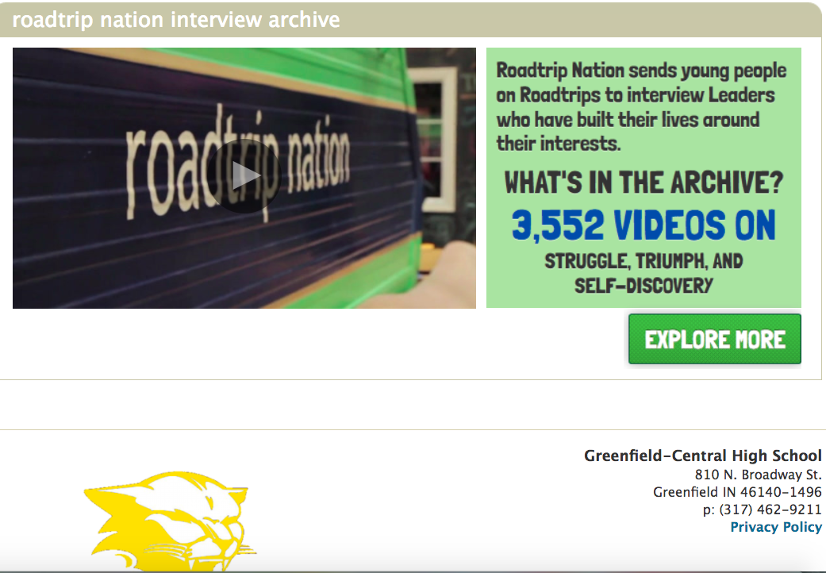
Family Connection
Family Connection is an online portal that allows students and families to do college and career exploration, as well as track the college application process for students and their counselors. All G-CHS students and families have access to Family Connection.

Slide 24
Helpful Information
Twenty-first Century Scholars
G-CHS Counseling Web Page
Indiana Department of Education: http://www.doe.in.gov/
Twenty-first Century Scholars: http://www.in.gov/21stcenturyscholars/
G-CHS Counseling Page (curriculum guide): http://gchs.gcsc.k12.in.us/?p=11444
G-CHS Athletics Page (paperwork-Rank One): https://greenfield-central.rankonesport.com/Main/Default2.aspx?Type=4

Slide 25
Follow us on Social Media & in Family Connection
family connection
Follow Greenfield-Central High School on Twitter (@GreenfieldCHS), Facebook, and the Counseling Department on Remind. We post lots of great information and updates through these programs.
Also, follow Cougar athletics through Twitter @GCCougars.

Slide 26
Questions?

